Slide 1
Group Poster Preparation:
Showcase Wed March 6, 2019
November, 2018
Dr Mike Wride
wridem@tcd.ie
@WrideMike
  CAPSL

Slide 2

Mobile Phones!
The next 2 hours are Mobile Phone Free!
Switch off/mute your phones and put them away.
We need no distractions!

Slide 3
Key dates for ‘New-Directions’ 18-19
Item: | Dates:
Assignment Feedback: | Dec 20, 2018
Assignment Resubmission Deadline: | Jan 15, 2019
Poster Submission Deadline: | Feb 15, 2019
Poster Feedback: | Feb 28, 2019
Showcase Event: | March 6, 2019

Slide 4
Poster Development Session: Outline
Poster guidelines
Form the groups
Brainstorm ideas: Two stage process
  Individually
  In the group
Explain the theme of your poster to the other participants
Feedback, questions and discussion
Use design thinking to develop your ideas
Plan the work using the template provided

Slide 5
Poster Ideas:
What we learned from CoPs
applying technology to enhance teaching
Innovative strategies for handling large groups
creativity in the classroom
Innovations in assessment
Evaluating and reflecting on your teaching to change your practice
using learning outcomes to promote student learning
using peer- and/or self-assessment
responding to student feedback;
facilitating group work / capstone projects
Promoting student self-regulation and motivation
Leadership in teaching

Slide 6
You should produce a poster that…
Is logically organised, visually appealing and neatly presented
Is well written and concise
Includes photographs/graphs/tables/diagrams relevant to the project that are well presented and easy to see with appropriate titles and captions and labels that are easy to understand
Is not cluttered
Has clear diagrams and tables
Uses a font size not less than 28 point for all parts of the poster with the title size 72-96 point.

Slide 7

Design Thinking

Slide 8

Template
Novembr 2017
A suggested structure:
Title, Authors and Affiliations,
Aims,
Overview (methods, results),
Impact (discussion, reflections),
References,
Acknowledgements, Contact Details.
Use your creativity!

Slide 9
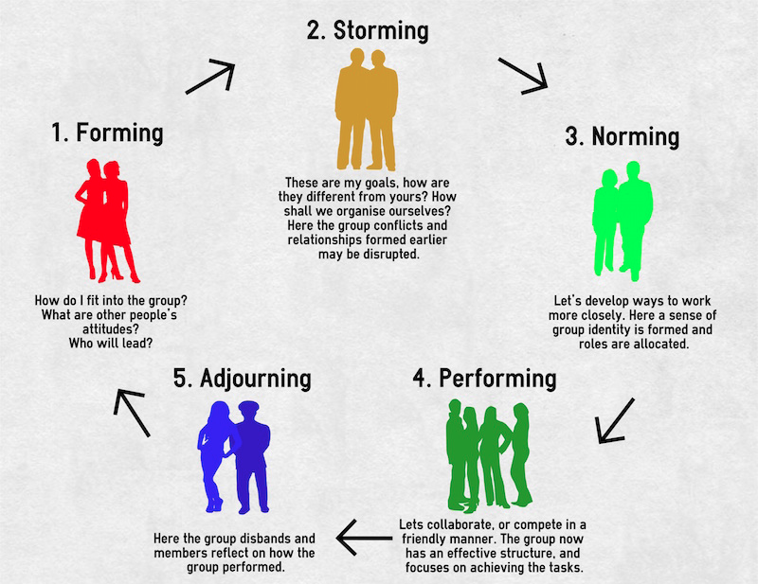
Form the Groups
5 per group
Different faculties/Departments
Different levels of seniority
Balance of males vs females

Slide 10
Group Poster: Developing ideas
November 2018
Individually – 5-10 mins:
Reflect on this question and write a list or mind-map of your ideas….
“What are the most important/useful/interesting things you have personally gained from the ‘New Directions’ course?”
Focus on Quantity not Quality: work quickly.
Consider both theory and your teaching practice.

Slide 11
Group Poster: Developing themes
In the Group - 10-15 mins:
Each write down your ideas together as key words/short sentences on a large piece of paper as a ‘mind map’.
Reflect on this question: “What links can you see between the ideas you have generated?”
You can use lines, bubbles, arrows etc. to link/highlight particular ideas, that fit together and cross out the ones that don’t.
Ask the question: “What themes are emerging?”

Slide 12

Group Poster: Refining the Theme
In the Group:
Work together to refine a theme for your group poster that you are all comfortable with.
Ask the Question:
“What would be of most interest to our colleagues?”
There will need to be compromise, but also there is the possibility that something new will emerge that you had not seen previously…
Present a brief overview of the poster idea to everyone: questions and answers, suggestions.

Slide 13
Plan the Poster
Overview
A cohesive Whole NOT Five independent parts: divide up the work but make it connect: freedom versus coherence.
Methods
Results
Aims
The theme for the poster is:________
Impact
Tables
Reflections
Discussion
Figures
References
Focus on Content

Slide 14
Produce a rough draft of the layout on a large sheet of paper
TITLE
OVERVIEW
AIMS
IMPACT
FIG
REFS

Slide 15
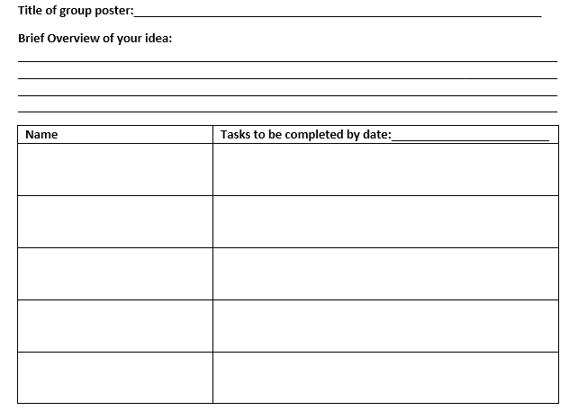
Group Poster Planning Template
November 2016

Slide 16
Thank You

